Slide 1
Sprint 1 Demo
Adrian Muth, Benjamin Chong, Jennifer Brana, Pranav Rajan, Tamsen Dean

Slide 2
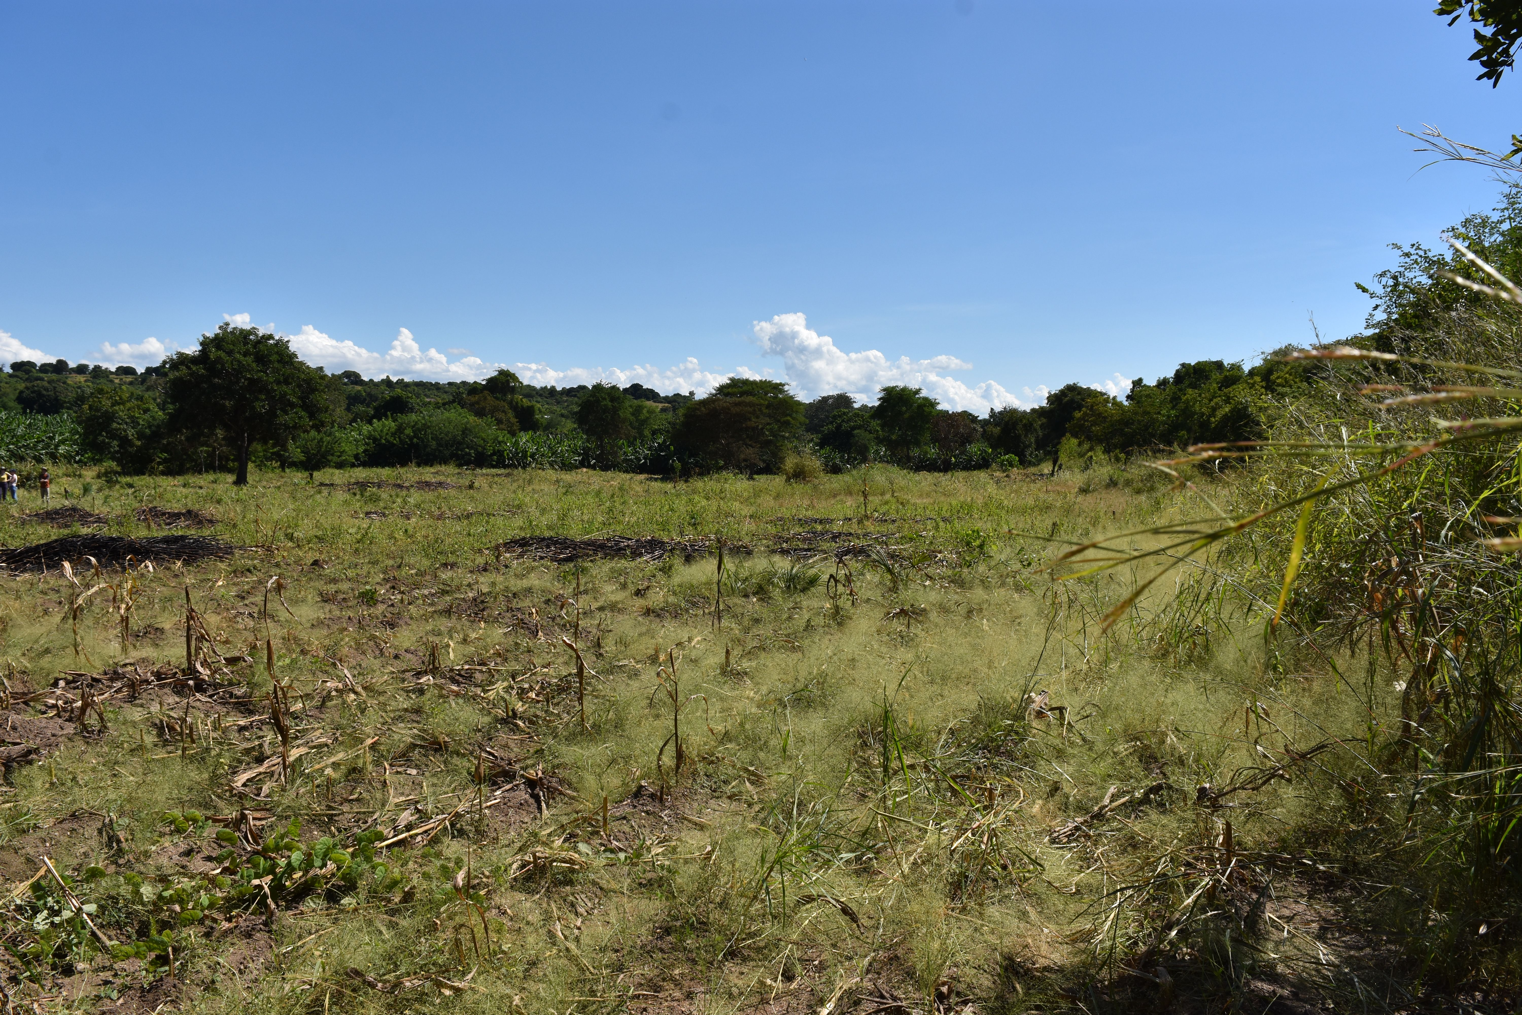
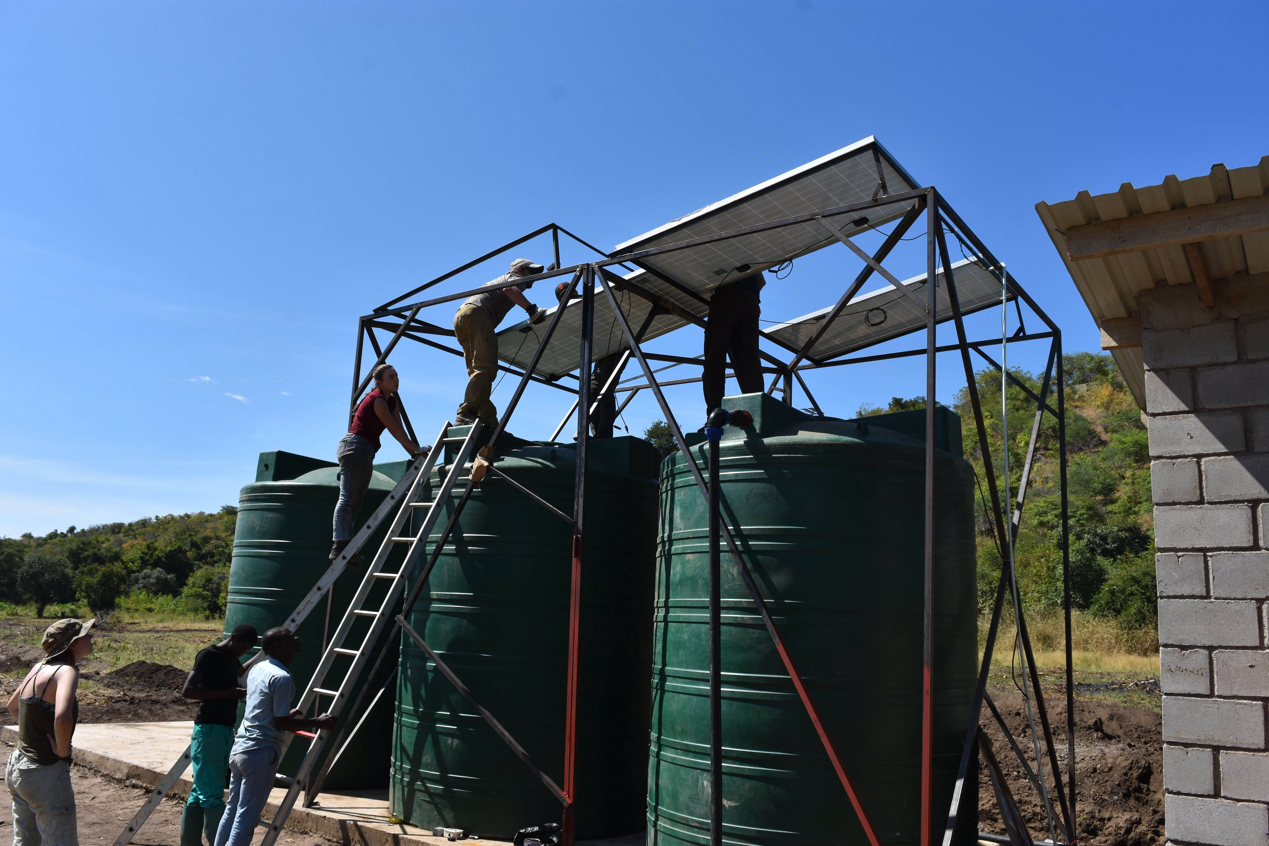
Purpose
Previous team's problem statement: Design a solar powered irrigation system for St. Mary's 3.25-hectare farm plot in order to allow the school to grow food year-round and educate local farmers regarding irrigation techniques and benefits.
Our task: Interface with the irrigation system to detect potential issues and monitor water flow
Notes:
Adrian
- st. Mary's secondary school for girls in malawai, africa
- civil and mechanical engineering team worked over the summer
- problem statement
- what are we doing and why we're doing it

Slide 3
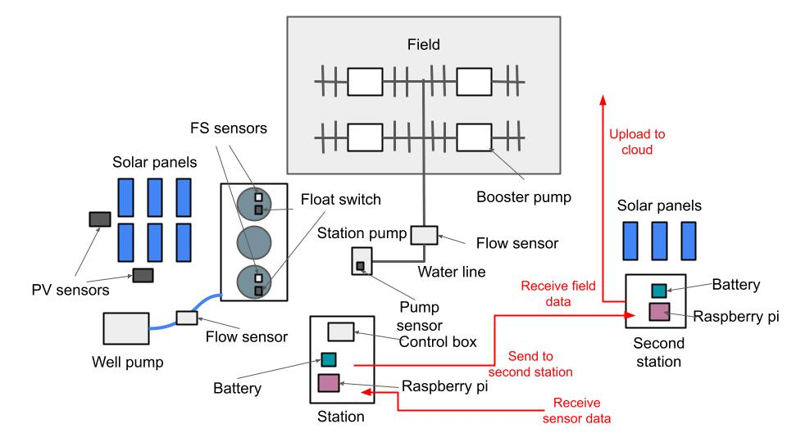
Project Overview

Slide 4

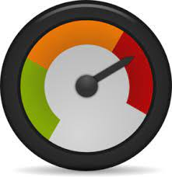

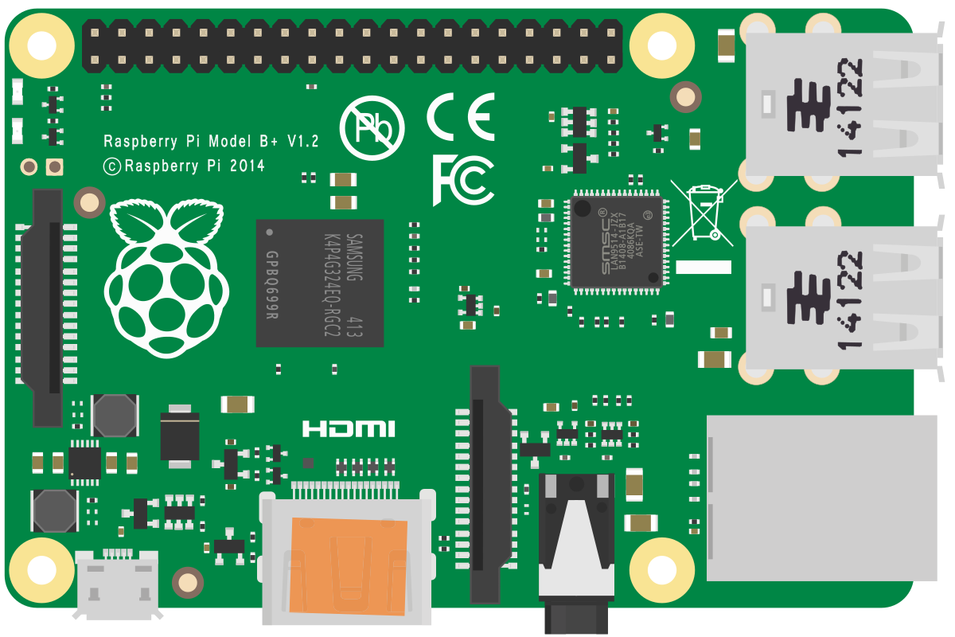


Project Overview (Cont.)
Cloud
Field Station
Service Station
Sensors
Arduino/ESP32
Raspberry Pi
Raspberry Pi
Wi-Fi Hotspot
RF Chip
RF Chip

Slide 5
Technologies
Hardware
Software
Arduino
Raspberry Pi
ESP 32
Flow meter
Radio Chip
Power source and connectivity
Raspberry Pi OS: Raspbian
Python libraries for uploading to cloud: gspread, smtplib
MQTT for communicating with ESP32
Cronjob or Systemd for scheduling scripts
Notes:
Ben

Slide 6

Rough Plan and Time Period
Sprint 1 | Sprint 2 | Sprint 3 | Sprint 4
Communicate with clients and write up requirements | Set up circuits to communicate data | Gain access to test flow sensors | Recurrently send flow sensor data to cloud
Sprint 5 | Sprint 6 | Sprint 7 | Sprint 8
Create a working version of device | Test and simulate device | Optimization and reinforcement of system | Final fixes and project sendoff
Notes:
Tamsen

